Slide 1
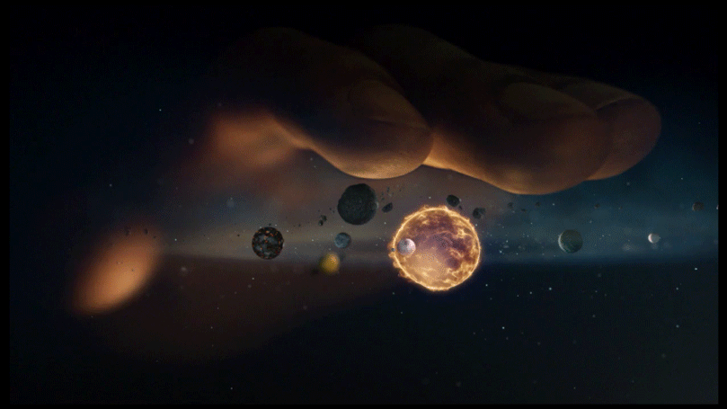
Web App Project by: Jamielyn Agliam

Slide 2

Purpose
The web app’s purpose is to give information or to educate children about the solar system in a more exciting way.
After learning about the basic information of the solar system, they would have a chance to test what they’ve learned through playing a game (quiz)

Slide 3

WEB APP DESIGN

Slide 4

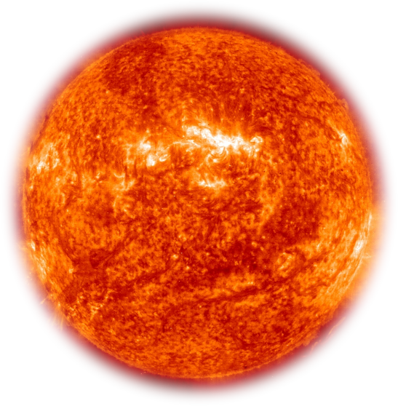
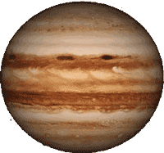
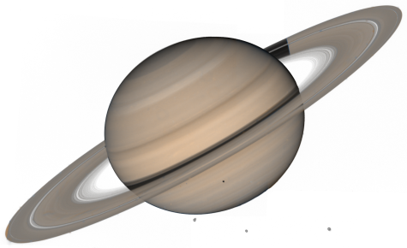
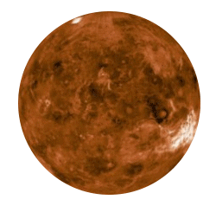

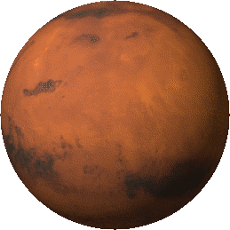
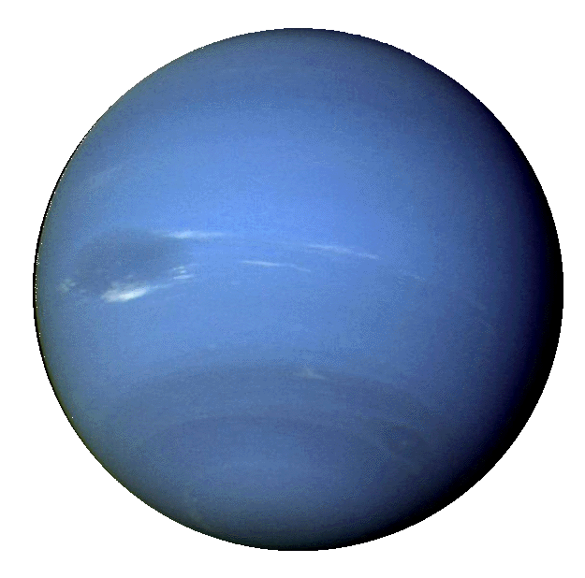
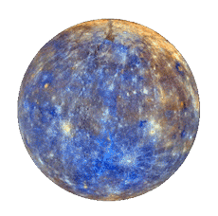

SOLAR SYSTEM (Click the planets to see its information)
LEARN
PLAY

Slide 5

SOLAR SYSTEM
LEARN
PLAY
What is the name of this planet?
a. Jupiter
b. Mars
c. Saturn
d. Neptune

Slide 6
SOLAR SYSTEM (Click the planets to see its information)
Planet Name
------------------------
Basic information about the planet…
Radius:
Mass:
Distance:
Rotation:
Moons:
LEARN
PLAY
Close

Slide 7
SOLAR SYSTEM (Click the planets to see its information)
Planet Name
------------------------
Basic information about the planet…
Radius:
Mass:
Distance:
Rotation:
Moons:
LEARN
PLAY
Close

Slide 8
SOLAR SYSTEM (Click the planets to see its information)
Planet Name
------------------------
Basic information about the planet…
Radius:
Mass:
Distance:
Rotation:
Moons:
LEARN
PLAY
Close

Slide 9
SOLAR SYSTEM
LEARN
PLAY
What is the name of this planet?
a. Jupiter
b. Mars
c. Saturn
d. Neptune
WRONG

Slide 10
SOLAR SYSTEM
LEARN
PLAY
What is the name of this planet?
a. Jupiter
b. Mars
c. Saturn
d. Neptune
CORRECT!

Slide 11
END

